Slide 1
Online Intro CEE 4590
Monroe Weber-Shirk

Slide 2
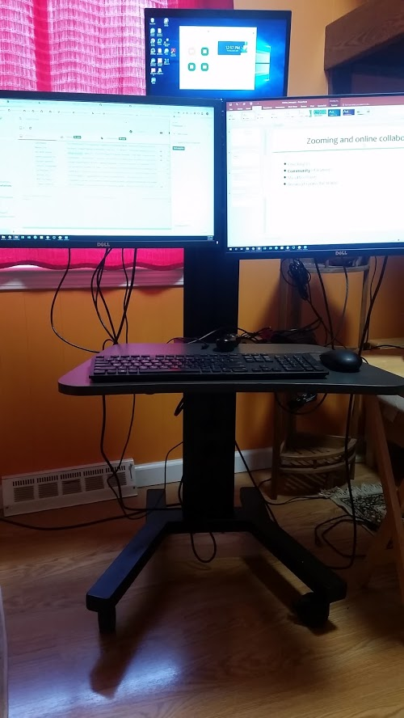
Zooming and online collaboration
Checking in in breakout rooms
Community of learners
Regular class time Zoom meetings
A time to check in on progress and provide guidance
Breakout rooms for teams with visits from TAs and Monroe
Teams presenting updates to the class
Guest lectures
My office hours (flexible in the afternoons)
Breakout rooms for teams (at the end of our meeting today)
Finish the Fairmont Intro design challenge asap!

Slide 3
Checking in in breakout rooms
One thing you did over the past 3 weeks
A hope for the rest of the spring semester at Cornell
An idea for how to maintain and build our online community of learners for 4590

Slide 4
So life is complicated right now
If your life gets complicated
Talk to me (email or phone or zoom or whatsApp or…)
I’ll respect your privacy. You don’t need to tell me why your life is complicated. Just tell me you need a break or whatever accommodation.

Slide 5
Community of learners
Learning how to create effective virtual meetings is a useful life skill for all of us
This is my first experience with online teaching and so I’m eager to hear your feedback and suggestions
I want to encourage the idea that we are all in the CEE 4590 office complex and you and your teammates can knock on my door using Zoom any afternoon!
I also have office hours at 3 pm every weekday afternoon
It takes extra effort to set up a face-to-face virtual meeting. Make that extra effort!

Slide 6
Tools for team collaboration
Synchronous (at the same time)
Asynchronous (not necessarily at the same time)
Meet via Zoom
Send text, audio, video via WhatsApp or other social media platform
Use meetings to discuss challenges, set strategy, and divide up tasks
During each virtual “face-to-face” meeting reflect on how to become more effective. (What was good, what could be improved…)
Create a shared task list (perhaps right in the Colab sheet) to guide your work
Push your revisions to GitHub and include lots of comments so your team members can take the next steps
Watch the GitHub site so you are notified of changes!

Slide 7
High Performing Teams
Use Agile principles (https://agilemanifesto.org/principles.html)
Perhaps create a basic preliminary design in two weeks.
Then refine and add details and ensure the design code continues to work with each revision
Remember: “The most efficient and effective method of conveying information to and within a development team is face-to-face conversation.”

Slide 8
Agile Capstone Design
Each create your own branch on github/4590FSP so you can edit without any concern about messing up each other’s work
Learn how to push and merge your work using GitHub
Agile, NOT WaterFall for the Capstone Design (google this!)
The Fairmont design and build project will use waterfall methodology (at least this is Monroe’s interpretation)
In this early exploratory phase an Agile approach will enable evolution and course corrections

Slide 9
4/9/2020 agenda
Create your team’s branch of the 4590FSP repository
Open your colab sheet (named for your team!)
Make a change
Save it to github to your branch
Start working on Basis of Design Criteria
Team meetings to discuss Basis of Design during class today, Tuesday, or in my office hours

Slide 10
4/14/20 Agenda
Watch 4590FSP https://github.com/MWSteams/4590FSP
Go to Github and change your username so it is readable by a human (include your name) https://github.com/settings/profile

